Slide 1



Integrated Program in Business Analytics
Employee’s Promotion Prediction
Team: (IPBA11-Group G)
PARTICIPANTS:
Ankit Dwivedi
Pooja Verma
Shahzeb Alam
Shubham Jain
Shubham Agrawal
Soorya Rajgopal
Vinita Mundada

Slide 2
Agenda
Business Problems and Objectives
Data Overview
Exploratory Data Analysis
Key Business Findings and Insights
Data Preparation and Pre-processing
Sanity checks, treatment and transformations for analytical dataset preparation
Model Development and Validations
Model comparisons on key scoring metrics and model finalization
Business Recommendations and Potential Business Impact

Slide 3

Business Problem Statement
Business Problem Statement
HR executives and managers spend lot of time on normalizing the data and identifying the right person with talents to be eligible for a promotion or a hike, and often employees feel there is a bias because it is a human decision. Hence the organization is looking to have a model which could predict the employees who are eligible for promotion.
Multiple attributes have been provided around Employee's past and current performance along with demographics.
Objectives :
To analyze the various parameters that can contribute to the promotion of an employee. The challenges in the data are the imbalance in the data, missing values and most of the data is either ordinal or categorical.
Based on the analysis, predict which employees will get the promotion based on various variables in the Data by performing below steps;
Explore and visualize the dataset.
Build a Machine Learning Model to predict if the employees has a higher probability of getting a promotion
Optimize the model using appropriate techniques
Generate a set of insights and recommendations that will help the company

Slide 4
Data Overview
Data obtained from above queries was subsequently combined and transformed to get the following fields, i.e, Data dictionary.
There are total 13 column/features in file ‘HR Analytics Promotion prediction Raw Data File.csv", out of which 5 are categorical.
This data covers employees from 9 different department, where maximum employees belongs to Sales and Marketing Department i.e., nearly 1/3rd of total employees.
There are total 34 regions whereas around 1/4th are from region 2. and nearly 2/3rd of the employees have only Bachelor's degree and are male and rest are female.
More than 75% employee has only taken one training. Age of the employees ranges from 20-60 years whereas around 75% employees are below 40 years.
The average rating of the employees is between 3-4.Less than 3% of the employees has received award at least once in their tenure.
The minimum score obtained in the training by any employee is 39 and avg score is 64.Only 8.5% of the total employees got promoted.
S.no | Field_name | Description
1 | employee_id | Unique ID for the employee
2 | department | Department of employee
3 | region | Region of employment (unordered)
4 | education | Education Level
5 | gender | Gender of Employee
6 | recruitment_channel | Channel of recruitment for employee
7 | no_ of_ trainings | no of other trainings completed in the previous year on soft skills, technical skills, etc.
8 | age | Age of Employee
9 | previous_ year_ rating | Employee Rating for the previous year
10 | length_ of_ service | Length of service in years
11 | awards_ won | if awards won during the previous year, then 1 else 0
12 | avg_ training_ score | Average score in current training evaluations
13 | is_promoted | (Target) Recommended for promotion

Slide 5

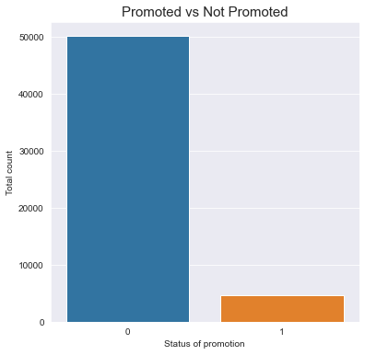
Exploratory Data Analysis and Visualization (Univariate and Bivariate)
Exploratory Data Analytics to understand the different aspects of data. It enables an in depth understanding of the dataset, define or discard hypotheses and create predictive models on a solid basis.
In the univariate, we will be analyzing a single attribute. But in the bivariate, will be analyzing an attribute with the target attribute.We will be performing, univariate analysis, bi-variate analysis, variable type analysis, null value analysis to interpret the data.
Below are the a few of the observations:
The dataset has a huge imbalance in the target classes. Training a classifier on imbalanced classes can prove problems in precision and recall of the model.

Slide 6
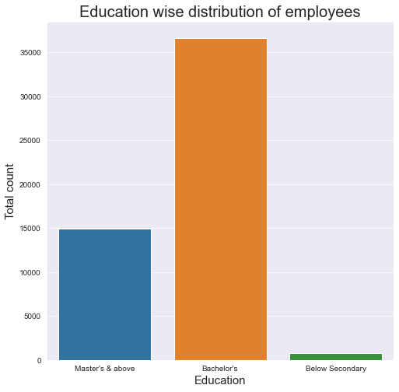


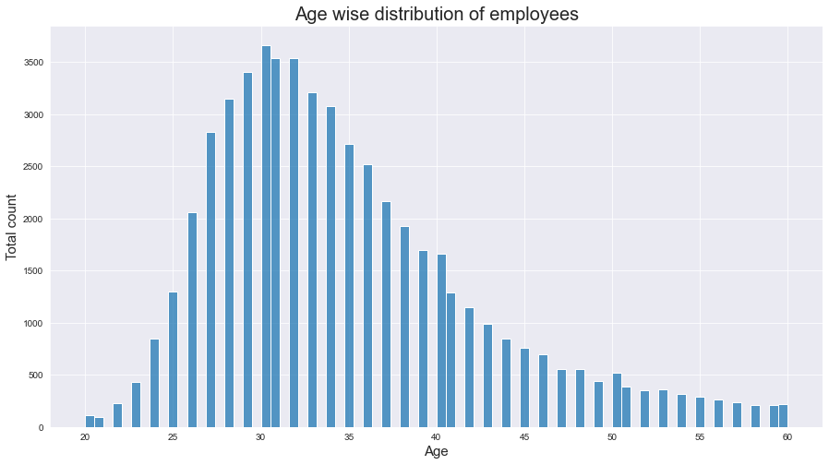
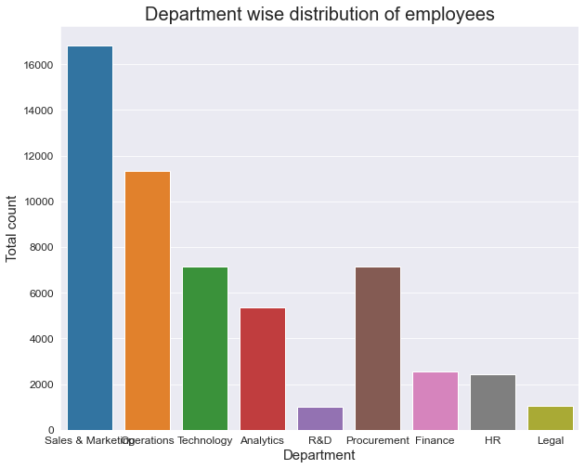
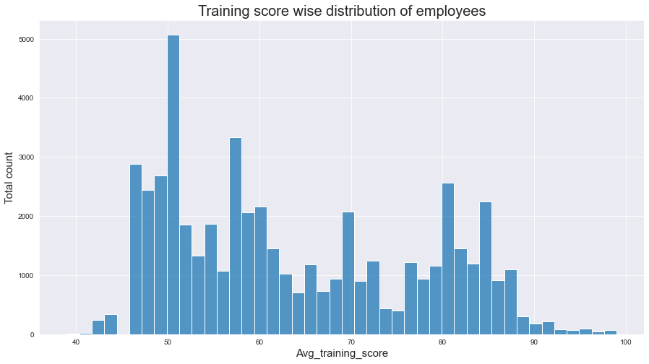
Univariate Analysis:
Around 70% employees have bachelor's degree and 30% have master's degree.
Age of the employees is between 24 to 40 years. Age class follows normal distribution. Maximum employees are of the age 31.
The columns total_count and avg_training_score specify the number of company organized workshops and trainings has the employee attended and the average training score the employee received for the said trainings.
Analyzing the Department column based on the above ,there are 9 unique departments in the company.

Slide 7
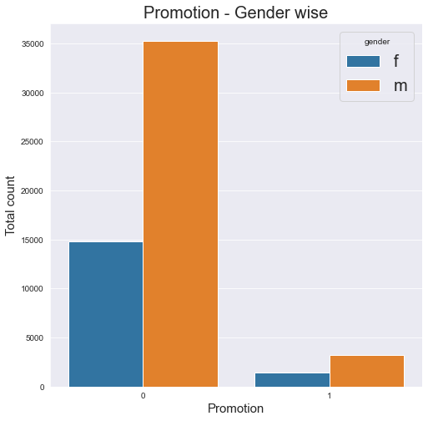
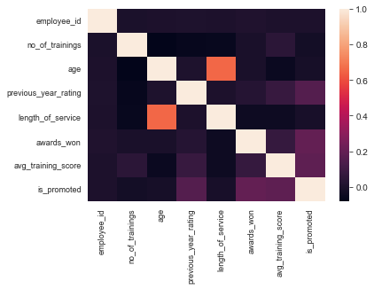
Bivariate Analysis:
Heat Map
Exploratory Data Analysis
It seems there is no such bias in giving promotion.
There is medium correlation between age and Length of service, we can drop age column as it seems less significant.

Slide 8
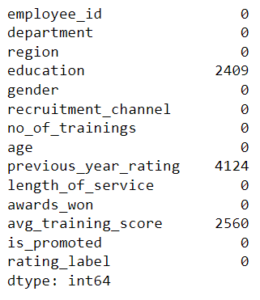
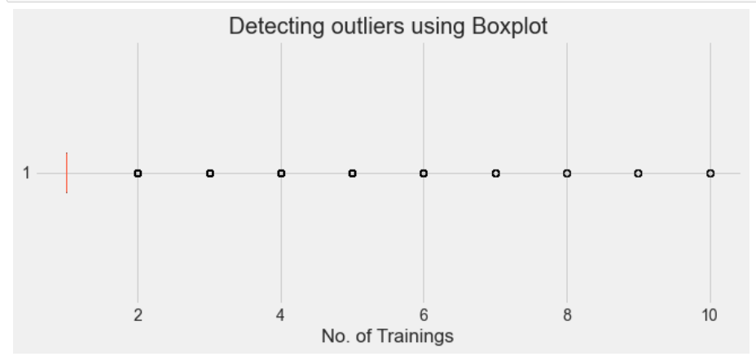
Missing Value Treatment and Detection & Treatment of Outlier
Missing Values Feature
Outliers
As the no. of trainings has outliers, dropping all the values above 5.
Previous year rating and average training score columns missing values are replaced with mean of the column.
The missing values of a categorical feature education is kept as NA.

Slide 9
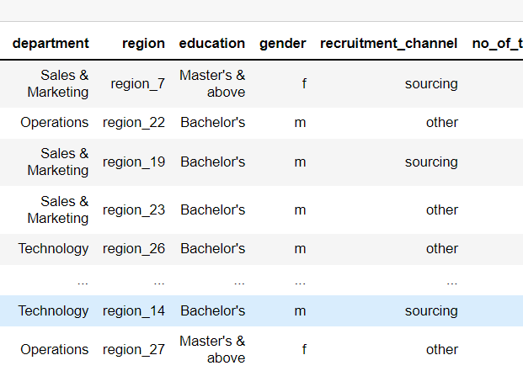
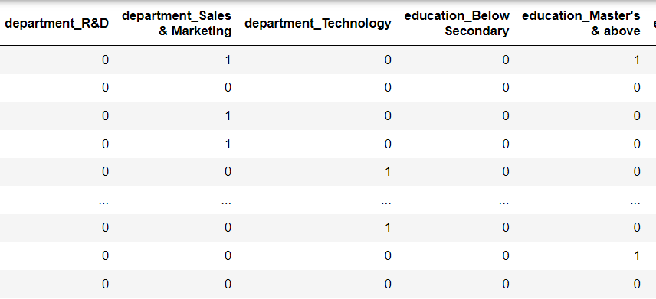
One Hot Encoding
Encoding refers to converting the labels into a numeric form so as to convert them into the machine-readable form. Machine learning algorithms can then decide in a better way how those labels must be operated. It is an important pre-processing step for the structured dataset in supervised learning.

Slide 10
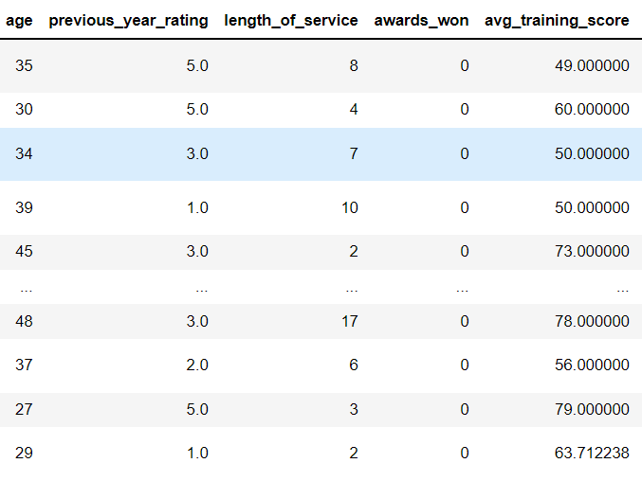
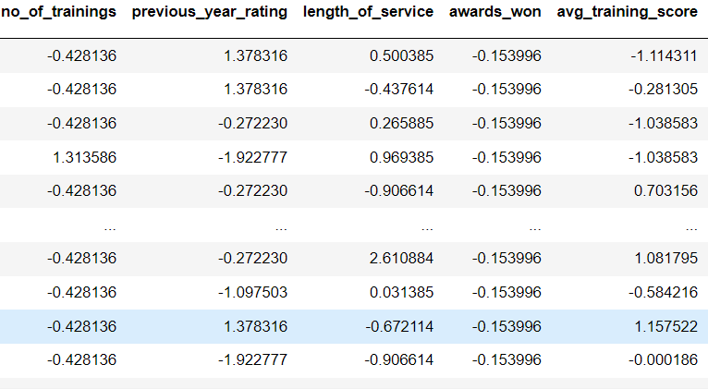
Feature Scaling - Standardization
Standardization is the transformation of features by subtracting from mean and dividing by standard deviation. This is often called as Z-score.
X_new = (X - mean)/Std
Standardization can be helpful in cases where the data follows a Gaussian distribution. However, this does not have to be necessarily true. Geometrically speaking, it translates the data to the mean vector of original data to the origin and squishes or expands the points if std is 1 respectively. We can see that we are just changing mean and standard deviation to a standard normal distribution which is still normal thus the shape of the distribution is not affected.
Standardization does not get affected by outliers because there is no predefined range of transformed features.

Slide 11
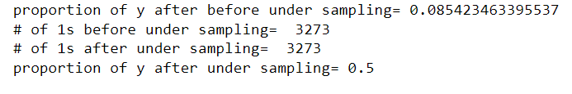
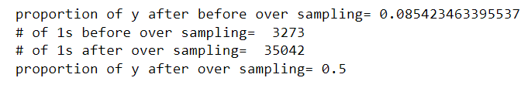
Over sampling and Under sampling
Random Undersampling: Randomly delete examples in the majority class.
Random Oversampling: Randomly duplicate examples in the minority class.

Slide 12
Cross Validation – Stratified K-Fold
This cross-validation object is a variation of K-Fold that returns stratified folds. The folds are made by preserving the percentage of samples for each class.
Generate test sets such that all contain the same distribution of classes, or as close as possible.
Be invariant to class label: relabeling y = ["Happy", "Sad"] to y = [1, 0] should not change the indices generated.
Preserve order dependencies in the dataset ordering, when shuffle=False: all samples from class k in some test set were contiguous in y, or separated in y by samples from classes other than k.
Generate test sets where the smallest and largest differ by at most one sample
Cross validation has been performed in 5 folds here.

Slide 13
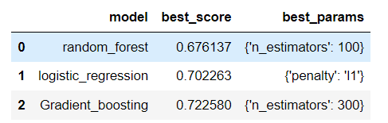
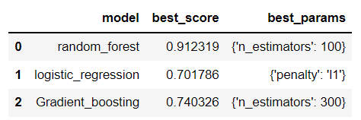
Grid Search CV
Grid Search CV is the process of performing hyperparameter tuning in order to determine the optimal values for a given model.
Random Under Sampling Random Over Sampling

Slide 14
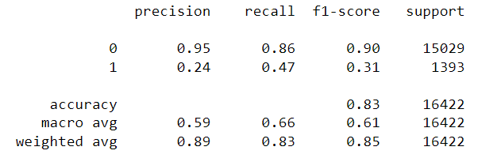
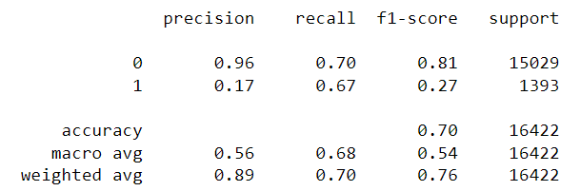
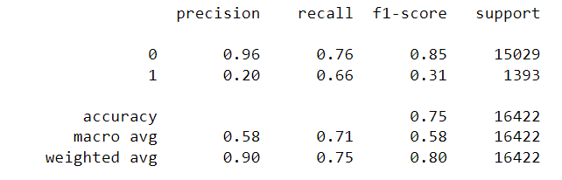
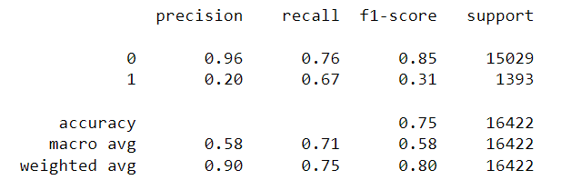
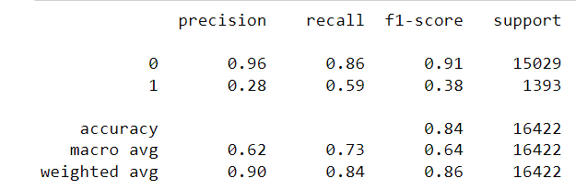
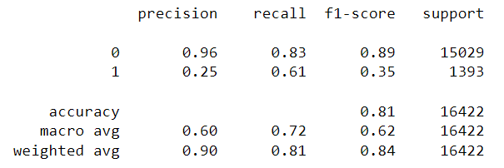
Metrices
Random Over Sampling Random Under Sampling
Random Forest Classifier
Logistic Regression
Gradient Boosting Classifier
Gradient Boosting Classifier

Slide 15
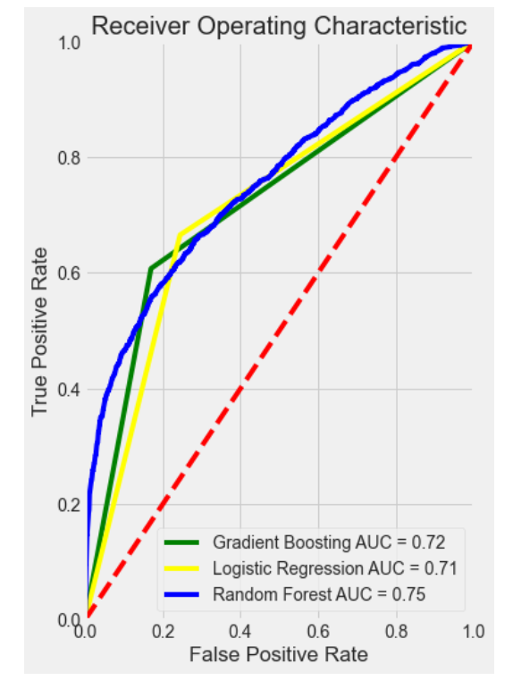
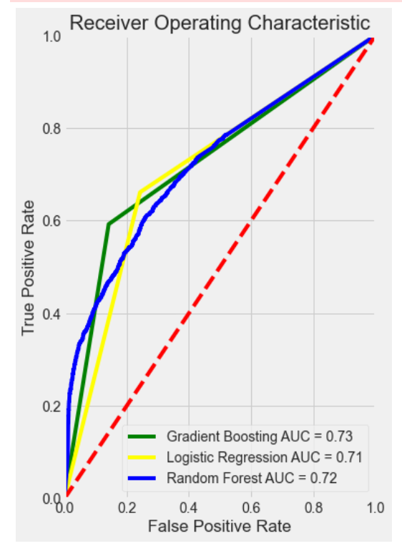
ROC and AUC Comparison
Random Under Sampling Random Over Sampling
Recommendation
As for Gradient boosting classifier AUC is 0.73 and recall and precision is highest among all. This method is most suitable and recommended to predict the employees promotion.
The Accuracy is also highest between 81 – 84% for both random under and over sampling method.

Slide 16
Business Recommendations and Potential Business Impact
The Sales & Marketing team has the highest number of promoted employees according to the bar plots, this can be because the Sales & Marketing team also has the highest total # of employees.
From the promoted employees, most of them hold a Bachelor's qualification. Bachelor's qualification is also the most frequent in the data and hence this can be accounted for.
These recommendations prove that department and education are indecisive when it comes to promotion. The extensive analysis conducted, led to the following recommendations on this dataset :-
The average training score and the number of trainings attended combine to give the total training score. Employees with Mediocre or High score are likely to be promoted.
Gender as a factor has no effect on the promotions of the employee, both the genders had about equal percentages of representatives from the two sets.
The most important factor amongst all is the previous year rating the employee received. The chances of promotions increase as the rating increases for an employee. New employees, that have 0 ratings also have a chance at promotion as, these ratings are not the only contributing factor.
Department and Education of an employee hardly gives much insight into which employee is likely to be promoted.
From the above, it can be said with confidence that no factor alone is responsible for the promotion of an employee. The following factors together can be considered for predictive modeling.
Length of Service
previous year rating
Total_training score
Award_won

Slide 17
Thank You

